Slide 1

MRI and Radiation Safety
Presented by the Radiology Quality Control Department

Slide 2

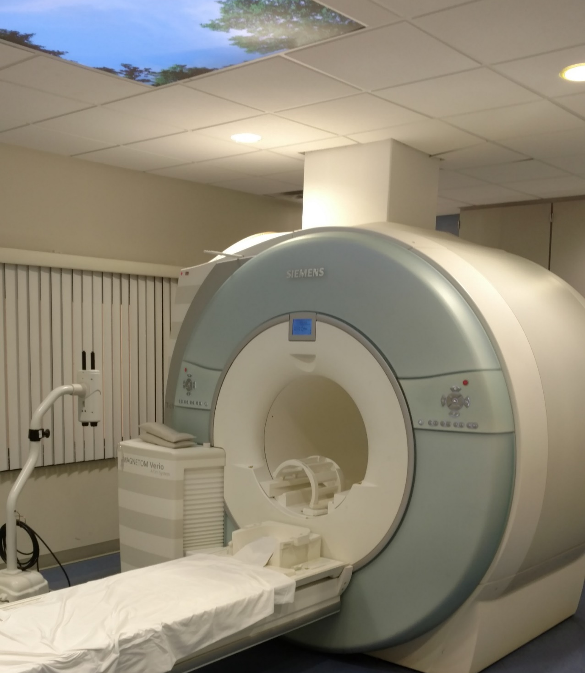
MRI Safety
The Magnet is ALWAYS on!
Whether it is 2:00 AM and no one is home
OR
In the Middle of a Busy Day

Slide 3
Signage in the Radiology area listing 4 MRI Safety Zones.
ZONE I
ZONE II
All areas freely accessible to the
general public without
supervision.
Still a public area, but this is the interface between the unregulated Zone I and the strictly regulated Zone III. MR safety screening typically occurs in this area under the direct supervision of the MRI Technologist.

Slide 4
MRI Safety Zones
ZONE III
ZONE IV
This is an area near the magnet room where the magnetic field is sufficiently strong enough to present a physical hazard to unscreened patients and personnel.
MRI Magnet room. This has the highest magnetic field strength and from which ALL ferrous (Metal) objects must be excluded.

Slide 5
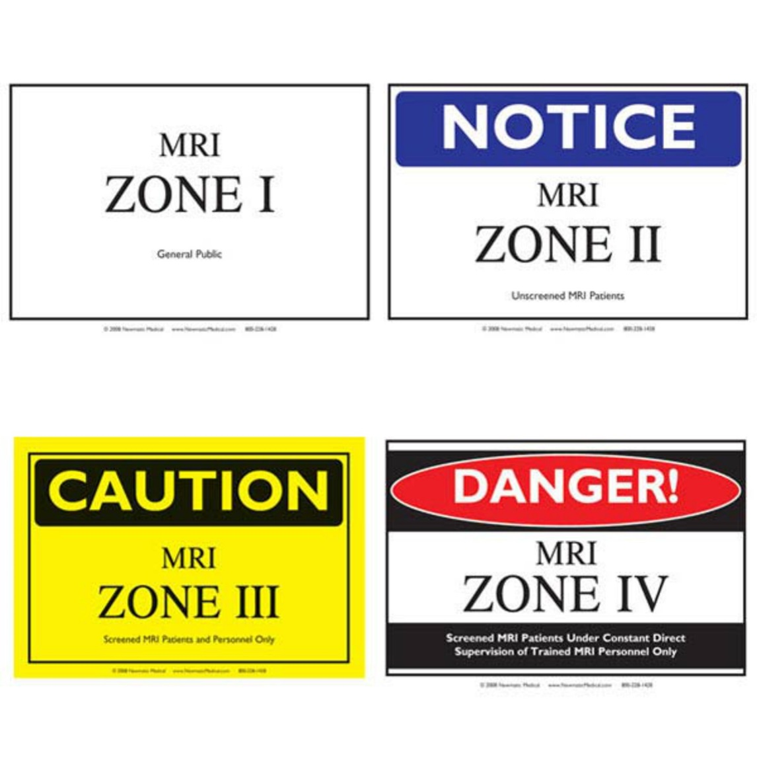
MRI Safety Zones

Slide 6
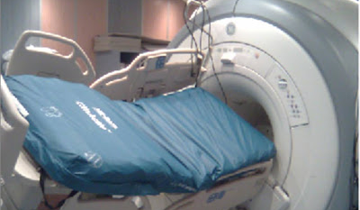
Powerful Electro Magnet
The MRI at MCHS is many times More Powerful than the Earth’s Gravity.
It WILL Take Ferrous (Metal)
Objects Away From You

Slide 7

Credit Cards
Cards are Read Using a Magnetic Strip the MRI Will ERASE Them!

Slide 8
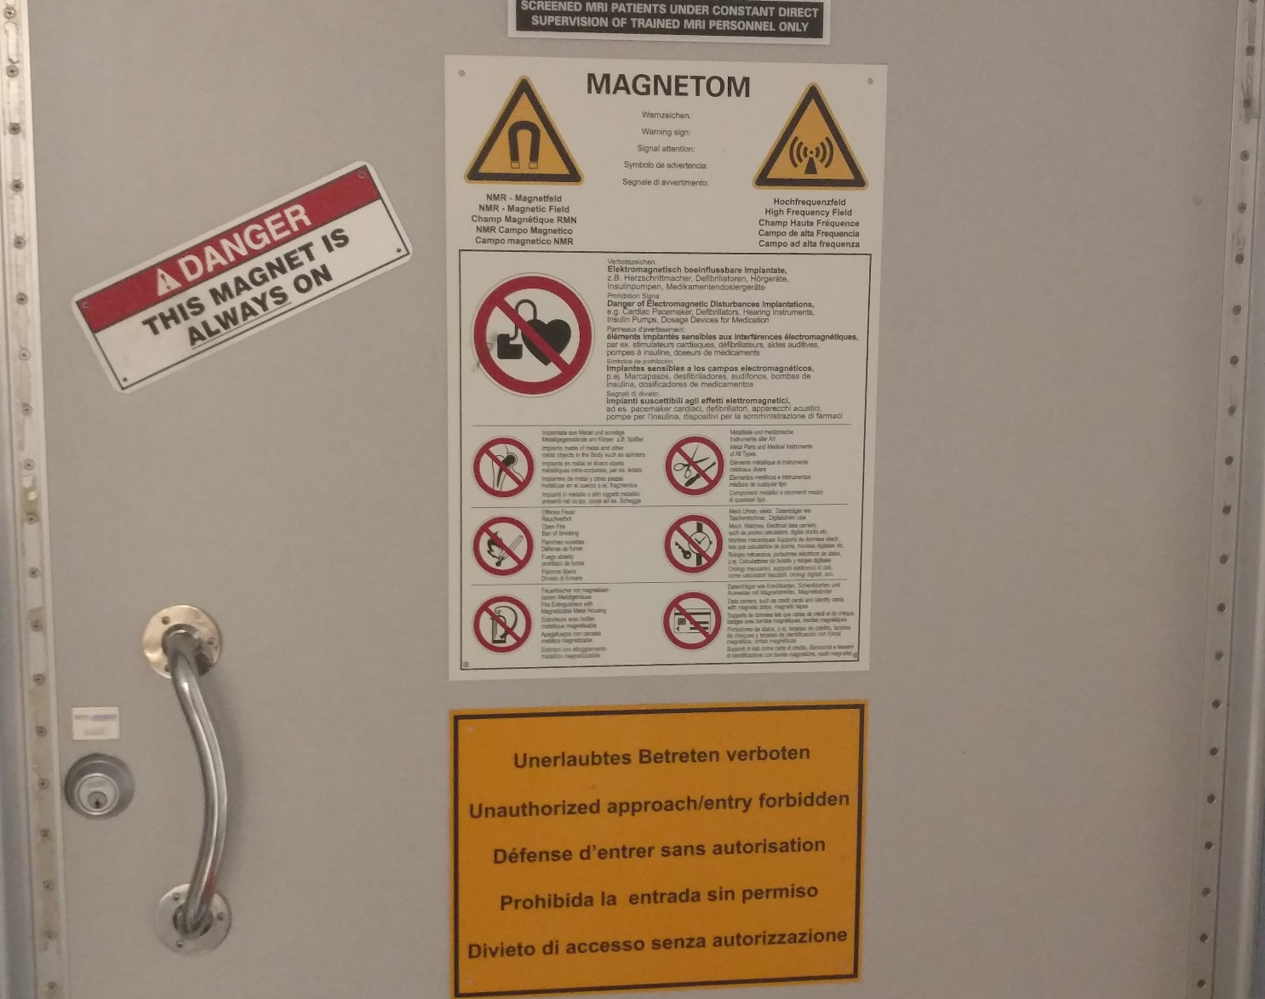
QUESTIONS
If you have any
Questions Regarding What Can and
What Cannot Enter the MRI Suite
Ask the Technologist on Site
They Know Their Stuff!
Just Remember

Slide 9
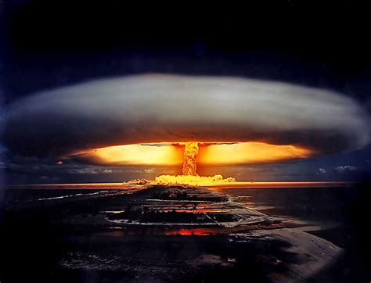
Radiation Safety
Let’s Discuss the
Different Types of
Radiation You Will
Encounter on the MCHS Campus

Slide 10

Naturally Occurring
Also Known as
Background Radiation
Or NORM
Naturally Occurring Radioactive Material

Slide 11
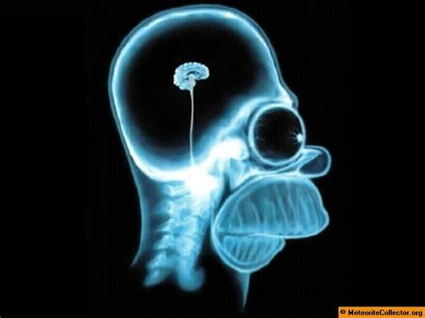
Electro-Magnetic
Electro-magnetically Produced
Radiation
X-Ray
Computerized Tomography (CT)
Special Procedures and Cath Lab

Slide 12
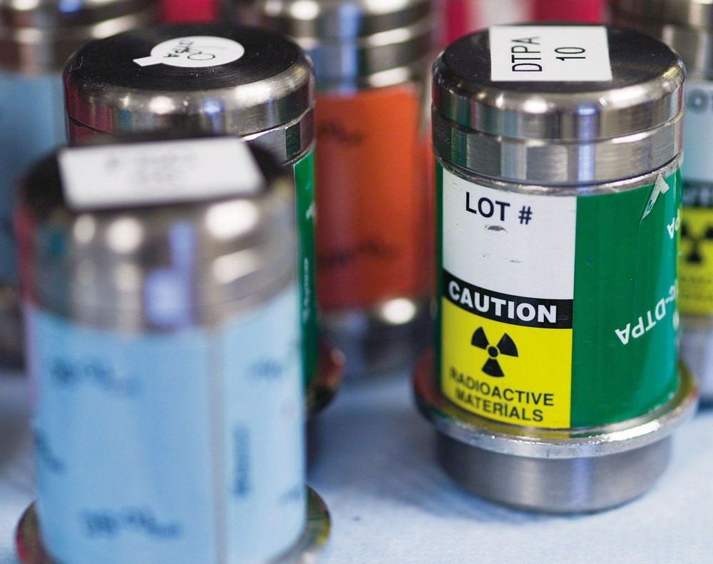
Radiopharmaceuticals
Radiopharmaceuticals
Used to Treat Disease
Radio-Isotopes
Used to Detect Disease

Slide 13
Radiation Causes Cellular and Biological Effects
Destruction of White Blood Cells
Destruction of Reticulocytes
Destruction of Reproductive Cells
Mutation of Genes

Slide 14
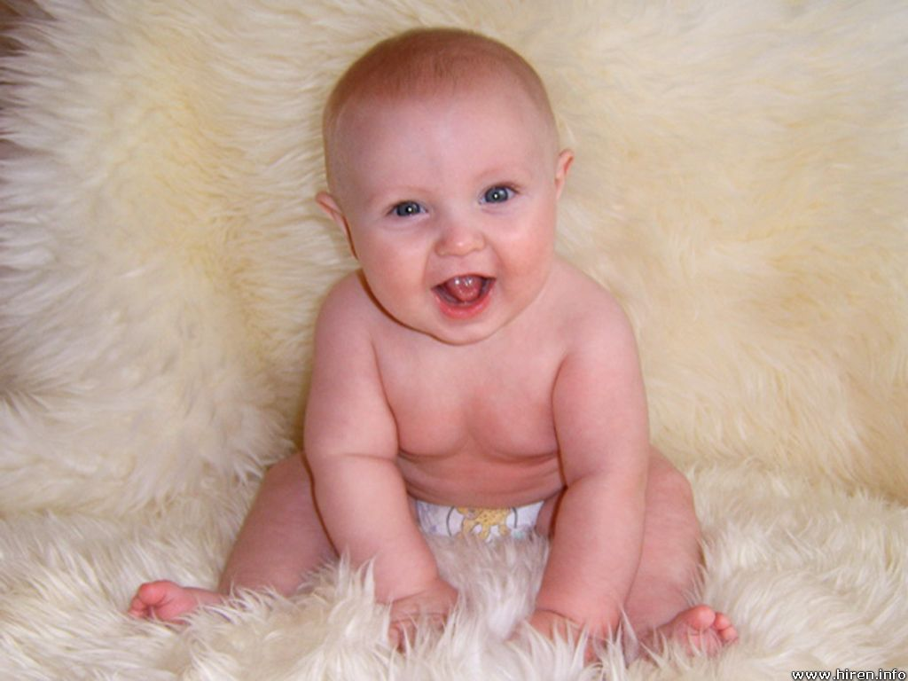
Cellular/Biological
During the First Trimester, Cells and Cellular
Mitosis Occur at a VERY Rapid Rate
If you Are or If you Think
You might be Pregnant
Let Your Immediate Supervisor Know
If you Work near a source of Radiation

Slide 15

The “Golden Rule”
The Golden Rule of
Radiation
Protection
REMEMBER THIS!!

Slide 16

TIME
Limit Time;
Limit
Radiation
Exposure

Slide 17
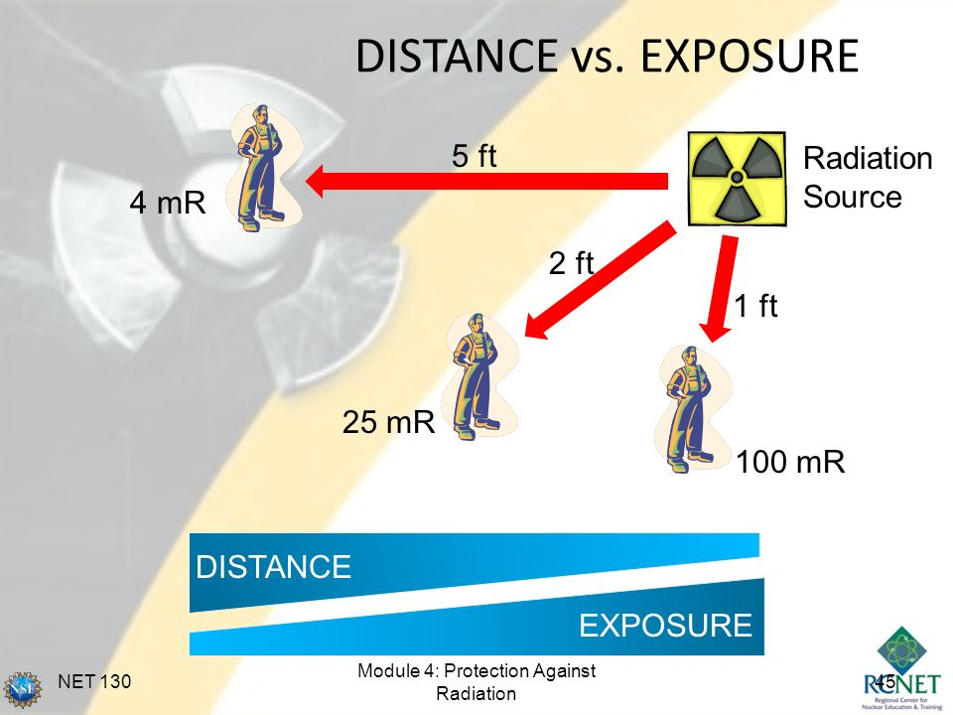
DISTANCE
Further From
A Source of
Radiation
Is
Better

Slide 18
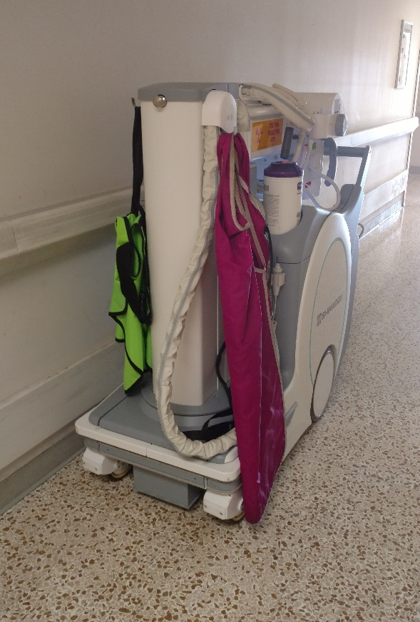
SHIELDING
Anything
Placed Between
You And the
Radiation Source

Slide 19

REMEMBER ANYTHING!

Slide 20
Radiation Detection
There are Many Different Types of Devices Used to Detect Radiation on
the MCHS Campus

Slide 21
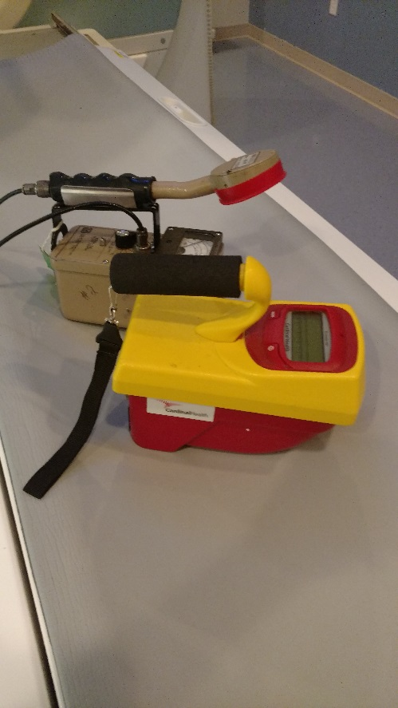
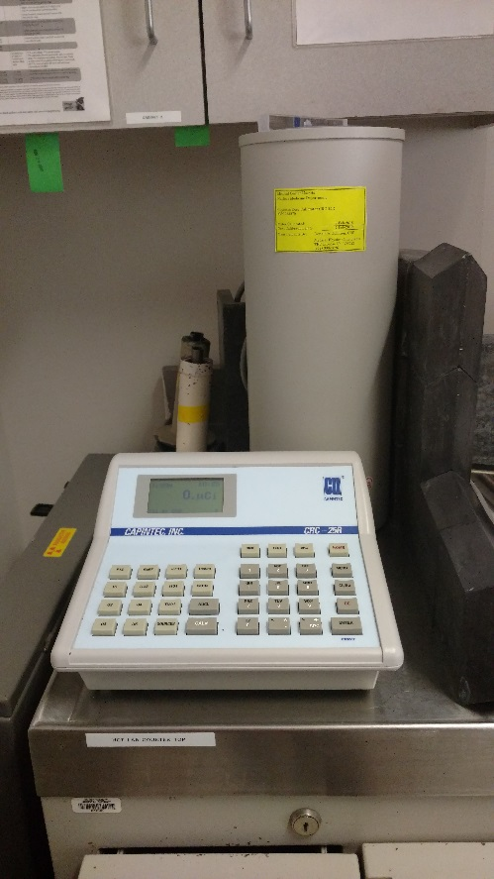
Electronic Devices
Geiger-Mueller Counter
Dose Calibrator

Slide 22
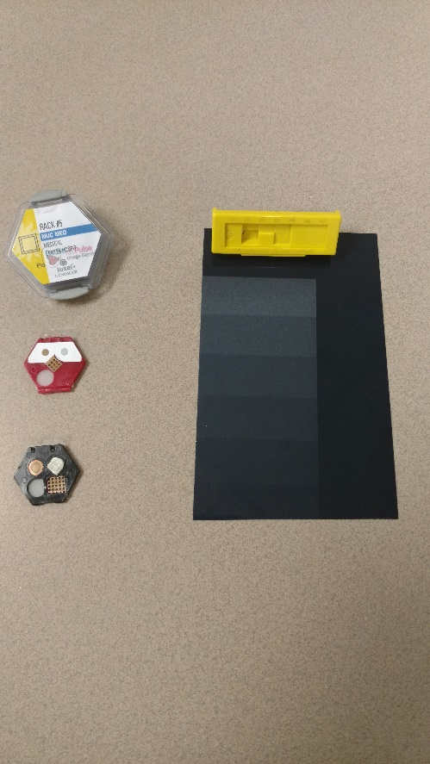
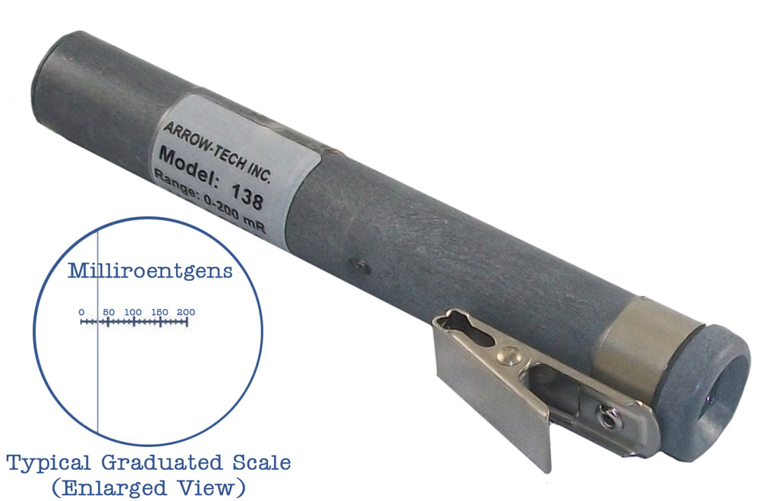
Dosimetry
T.L.D. or Film Badge
Pocket Dosimeter

Slide 23
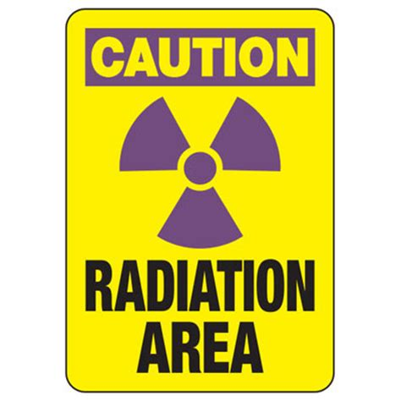
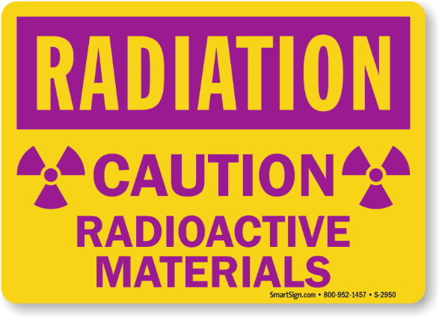
RADIATION WARNING SIGNS
ALL SIMILAR
ALL SIMILAR

